Slide 1

SAP BTP ABAP on Cloud / RAP Training
DAY-26
Anubhav Oberoy
www.AnubhavTrainings.com
Follow excellence with sheer passion

Slide 2


DISCLAIMER
The training content and delivery of this presentation is confidential, and cannot be recorded, or copied and distributed to any third party, without the written consent of Anubhav Trainings

Slide 3

01
Additional Save
02
Authorization
03
Precheck & Augment
04
Virtual Element
Notes:
https://pixabay.com/photos/san-francisco-transamerica-pyramid-1633203/

Slide 4
Additional Save
What is Additional Save?
Additional Save allows you to execute custom logic during the save sequence, after the main save has happened. It runs in the save phase of the RAP interaction cycle, meaning all validations and determinations are already done, the data is consistent, and now you just need to do something "extra" before or alongside committing.
You use Additional Save when you need to:
- Write to a legacy table or a table that is not managed by your RAP business object (e.g., a log table, a history table, or an old Z-table that still needs to be updated)
- Call an external API or function module as part of the save
- Trigger a side effect like sending a notification, updating a counter, or writing audit logs
- Basically any action that needs to happen at save time but outside the managed persistence
Where is it implemented?
It is implemented in the Saver class of your behavior implementation. You define the method `save_modified` and inside it, you write your additional logic. In the behavior definition, you declare it using the `additional save` keyword. It is only available in managed scenarios where the framework handles the main persistence, because in unmanaged RAP you are already writing all save logic yourself.
Simple analogy
Think of the standard save as checking out at a store — the cashier processes your items and charges you. Additional Save is like the store also printing a gift receipt, updating a loyalty points system, or sending you a confirmation email as part of that same checkout transaction. The main job is done, but there are extras happening at the same time.
www.anubhavtrainings.com

Slide 5
Authorization
Authorization control in RAP protects our business object against the unauthorized access of data. Authorization control is always relevant when the permission to execute an operation depends on a role of BO consumer. In the RAP, each read or modify request can be checked via authorization object against the user role before the request is finally executed and reaches data.
The auth check with auth object is called from cds entities in case of read request – was covered in Anubhav trainings abap on hana course
And behavior implementation in case of modify request
Global authorization
Global authorization is used for all authorization checks that only depends on the user.
Global authorization checks can be implemented both for static and instance bound operations
Instance authorization
Instance authorization is used for all auth checks that, in addition to the user role, depend on the state of the entity instance in question (like exact record level). Its only possible for instance based operation
Operations that are executed from instance auth are CREATE and static actions
Use case: when a user tries to edit a travel request, if the travel request status is cancelled, then we need to check that if he/she is a manager or not. Only managers can edit a cancelled travel request. Since each travel request is different, we need to go with instance-based authorizations.
www.anubhavtrainings.com

Slide 6






Prechecks
While the system is saving the draft in the draft table we can use prechecks to make sure that checks/authorizations are checked in the system before data reaches to draft table. Unlike validations (while saving/updating data to main table) Prechecks will trigger before data reaches to transaction buffer.
They are very helpful when we even want to validate data of one control based on another control. Currently as a developer you need to take additional pain to clean the data when draft is activated. If you apply precheck, system ensures that only the clean data reaches to transaction buffer.
Get The Country of Customer
Get The Country of Agency

Slide 7
Augment
Before data reaches to transaction buffer, the augment code will be executed and here we can set some default data to the BO instance.
www.anubhavtrainings.com

Slide 8
Virtual Elements
There is a requirement to expose extra elements out of cds entities for which there is no data inside the database, basically these element values are calculated at runtime (on-fly). If you worked with SAP UI5 development, we have similar concept called formatter. We have a implementing class in which we will add our code for calculating the runtime data of virtual elements.
Rules:
We should only add them to projection view. Because if you add in main view, your draft table will disturb and your main table will never have these column.
RAP does not support filtering and sorting of virtual elements, also the aggregation and group is not allowed
We cannot select data from virtual elements using direct SELECT or EML
We have to write implementation in a class for virtual element that class must use the interface IF_SADL_EXIT_CALC_ELEMENT_READ.
www.anubhavtrainings.com

Slide 9
Structure of the Fiori App
Currently you are testing the Fiori App by using the standard preview option in eclipse tool. Will our end user have the ability and skill to open eclipse tool, go to package and search BIMP and then open preview and that too in production system.
All the Fiori apps which we create in BTP will be called MTA – Multi target application, they are deployed with mta.yml file. Which will contain the configuration for the Fiori App.
In SAP BTP, there is a storage space called html-5-repository where the BTP will store our Fiori apps.
When we deploy our app, there is html5-deployer which will take our app from BAS tool and deployes it to the HTML5 Repository (Design time)
When we run the app, there is a service called html5-rt (runtime) service which will load our app from the repository in the build workzone.
Apart from that the application will contain a connectivity service to communicate with our abap on cloud system.
And a destination service which will read the destination (RFC) of AOC system to access data in Fiori.
www.anubhavtrainings.com

Slide 10
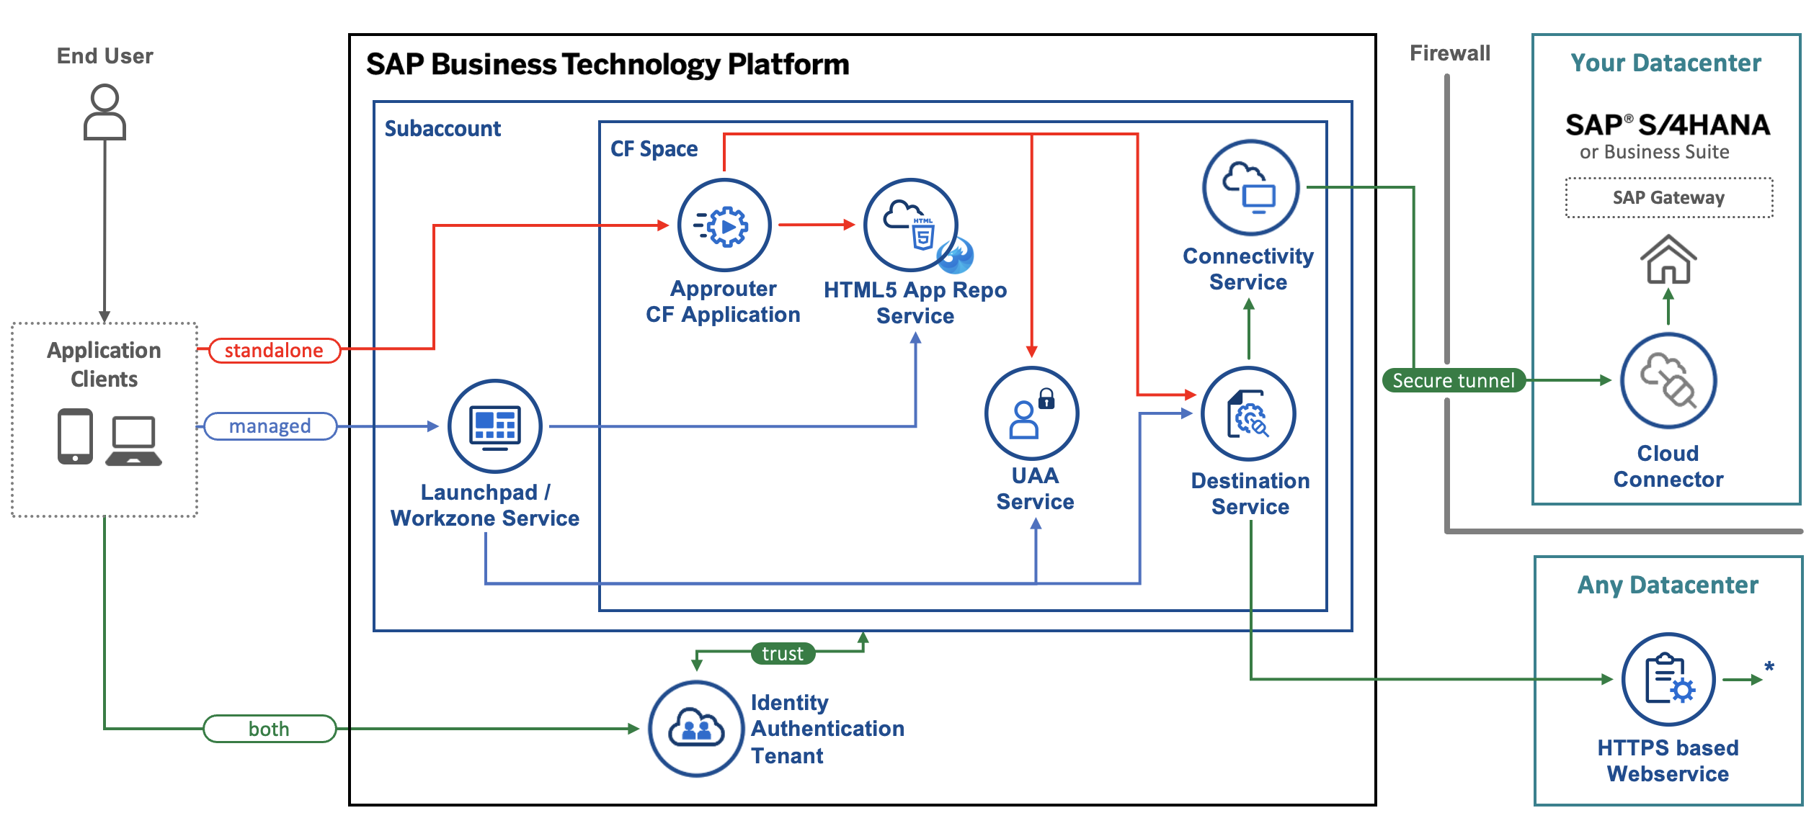
Architecture
www.anubhavtrainings.com
Notes:
https://www.google.com/url?sa=i&url=https%3A%2F%2Fcommunity.sap.com%2Ft5%2Ftechnology-blogs-by-sap%2Fbuild-and-deploy-ui5-freestyle-applications-to-sap-btp-cloud-foundry%2Fba-p%2F13558501&psig=AOvVaw3K_6niI7dmyPfs2VgcYMQf&ust=1726066695091000&source=images&cd=vfe&opi=89978449&ved=0CBcQjhxqFwoTCOicgdPRuIgDFQAAAAAdAAAAABAg

Slide 11
Tools and Services to Deliver the App
Business Application Studio – It is a multi cloud development tool which allows developers to build, test, package, deploy, and manage end to end Fiori applications.
SAP build work zone (aka cFLP in BTP) – it helps us to configure a site called Fiori launchpad in the cloud. All the Fiori Apps which you build in BTP will be accessed via this build workzone from end user. End user will get single URL, which contains the tiles for all our apps deployed in BTP.
Continuous Integration Service – When a developer change the application, and push to central repository like git, the CI service will automatically build and deploy our app.
www.anubhavtrainings.com

Slide 12
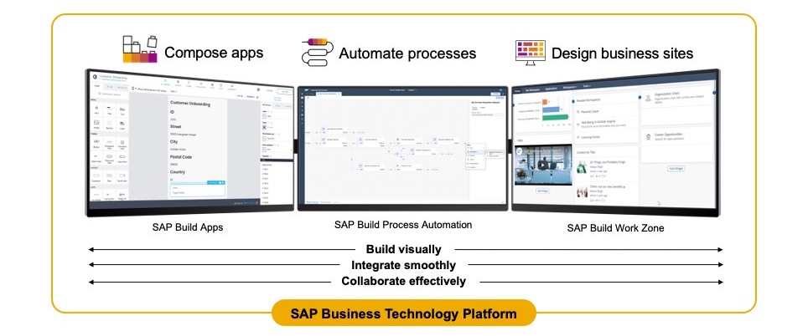
SAP Build – An introduction
www.anubhavtrainings.com

Slide 13
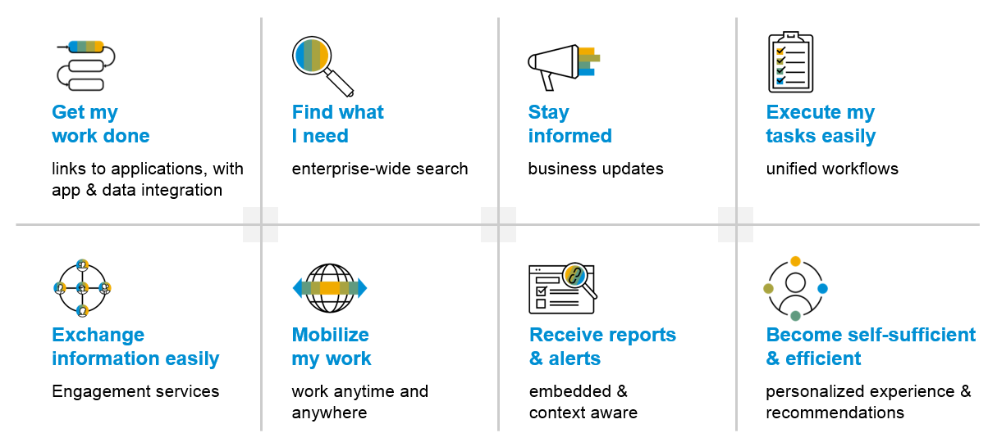
SAP Build Work zone – Key benefits
www.anubhavtrainings.com

Slide 14
Additional configuration before deployment
{
"xsappname": "comatstproctravelprocessorapp",
"tenant-mode": "dedicated",
"description": "Security profile of called application",
"scopes": [],
"role-templates": [],
"oauth2-configuration": {
"token-validity": 60000,
"refresh-token-validity": 2592000,
"redirect-uris": [
"https://.cfapps.us10-001.hana.ondemand.com/login/callback"
]
}
}
www.anubhavtrainings.com

Slide 15
How did Anubhav build and deploy fiori
Create the Dev space in BAS tool
Open the bas tool and open folder to choose projects folder
We have to open terminal and login to btp a/c cf login -a https://api.cf.us10-001.hana.ondemand.com --sso
Press F1 and choose open application generator to generate Fiori app of template: List Report Template
Select the system as AOC and choose our service binding name for processor
Provide app details, deployment details (btp), launchpad details and create app
Right click on mta.yml and build MTA archieve
Choose F1, open application info and select deploy
Assign the roles of our Launchpad service to our user
Open SAP Build workzone and create a site with name mylaunchpad
Go to channel manager and refresh the apps which are stored in html5-repository
Go to content manager and choose content explorer and pull the app
Create a catalog and a group and add our app to them
Go to everyone role and assign the app to the role
Open the site to test our app
Repeat the same steps if there is a change in the app.
We need to create a git repository and push our app code (backup)
Register a web hook and use the same in CI CD service so that the application will deploy automatically to BTP cloud
www.anubhavtrainings.com

Slide 16
Git and ABAP on git
Git is a source code repository management system, git hub is a repository on internet. We interact with github using git software. If I want to take a backup of all our code which we created in AOC system, git is a great choice. This way we can also export import our code between cloud and on-premise system.
For cloud system, we use git plugin in eclipse which is provided by SAP. The installation was covered in 3rd session.
Steps:
We need to add the plugin for abap git in ADT - http://eclipse.abapgit.org/updatesite/
Create a github account and add a PAT token under developer setting
Create a repository in git hub
Click on Add to link a repository and paste url from step 3
www.anubhavtrainings.com

Slide 17
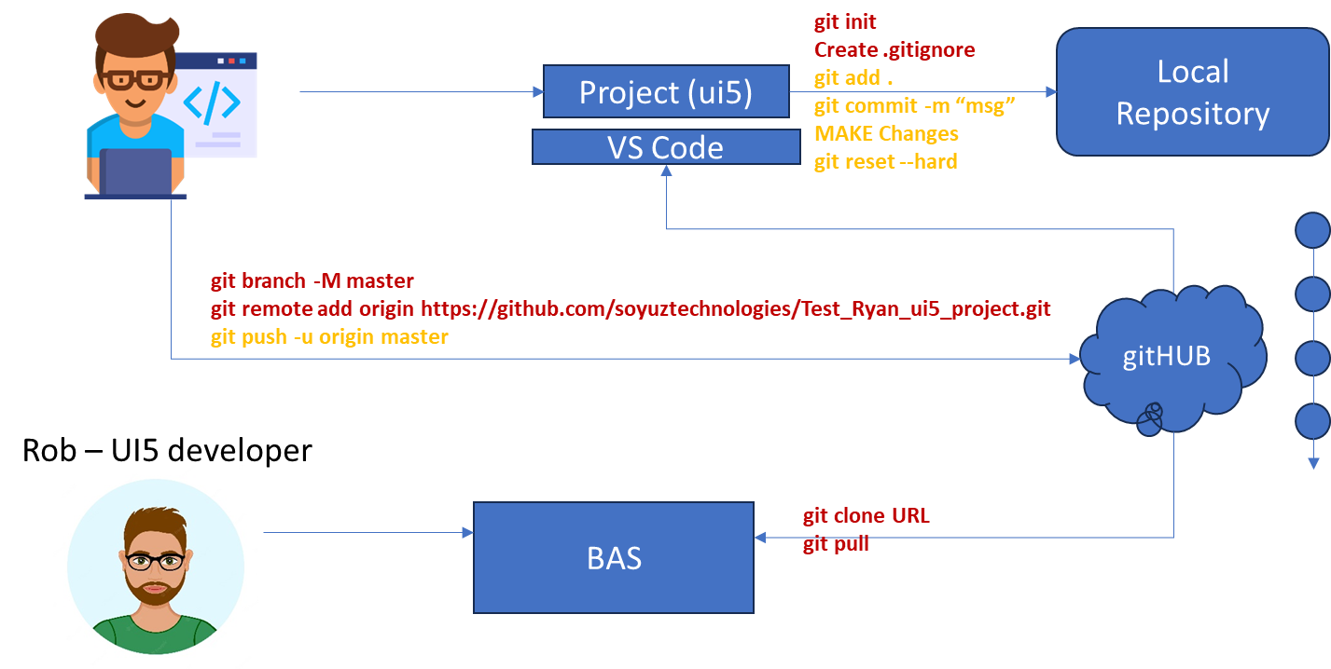
Git and Git HUB

Slide 18
www.anubhavtrainings.com
Thank You
End of Day 15
www.anubhavtrainings.com

Slide 19


We’re committed to empower you to be
FutureReady
through powerful training solutions.
We build the workforce of the future.
250+
Corporate Clients
30,000+
Learners Trained
25000+
Learners Placed
FREE WEBINARS
Sign up for free webinars with industry experts every fortnight!
Enroll Now!
Contact us today!
https://anubhavtrainings.com

